Slide 1



Fire Risk Dashboard — Bosque Pehuén
Data Visualization Program
Video Presentation
Student: Felipe Guarda
With the support of Fundación Mar Adentro
Notes:
Hello, I'm Felipe Guarda, thank you very much for this opportunity Mr. Caban. This presentation demonstrates a data visualization project focused on wildfire risk assessment and forecast for the neighboring area of Bosque Pehuén, a privately protected area in southern Chile managed by Fundación Mar Adentro, the foundation I currently work in, and thanks to which I could enroll in your program.

Slide 2
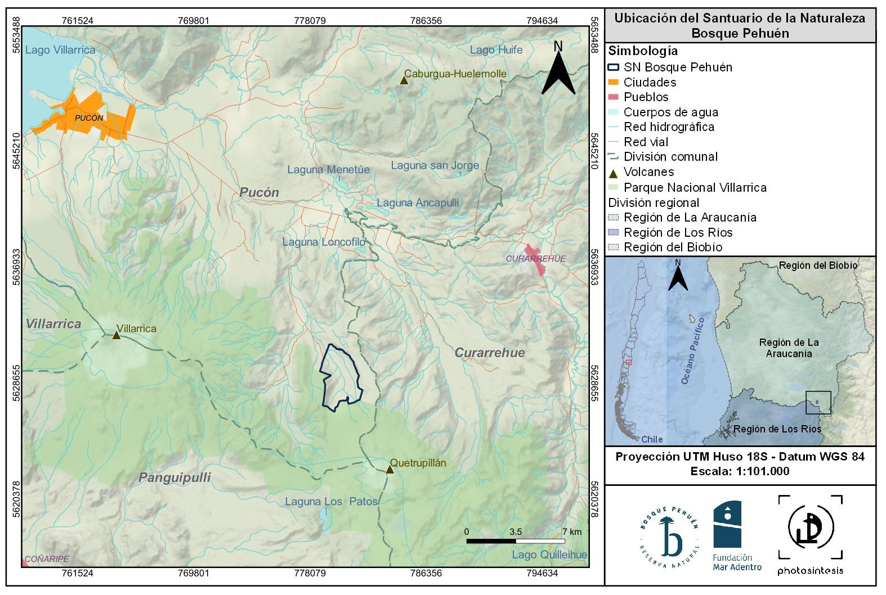

Notes:
So firstly, Wildfire is a critical threat to ecosystems and communities in Chile's Araucanía region. Wildfires occur every year, with consuming between 1,236 acres to 2,000 a year.
In this sense, Tthe core problem is: How can we effectively communicate fire risk in real time, so land managers and communities can prepare, and hopefully prevent, fire outbrakes.

Slide 3

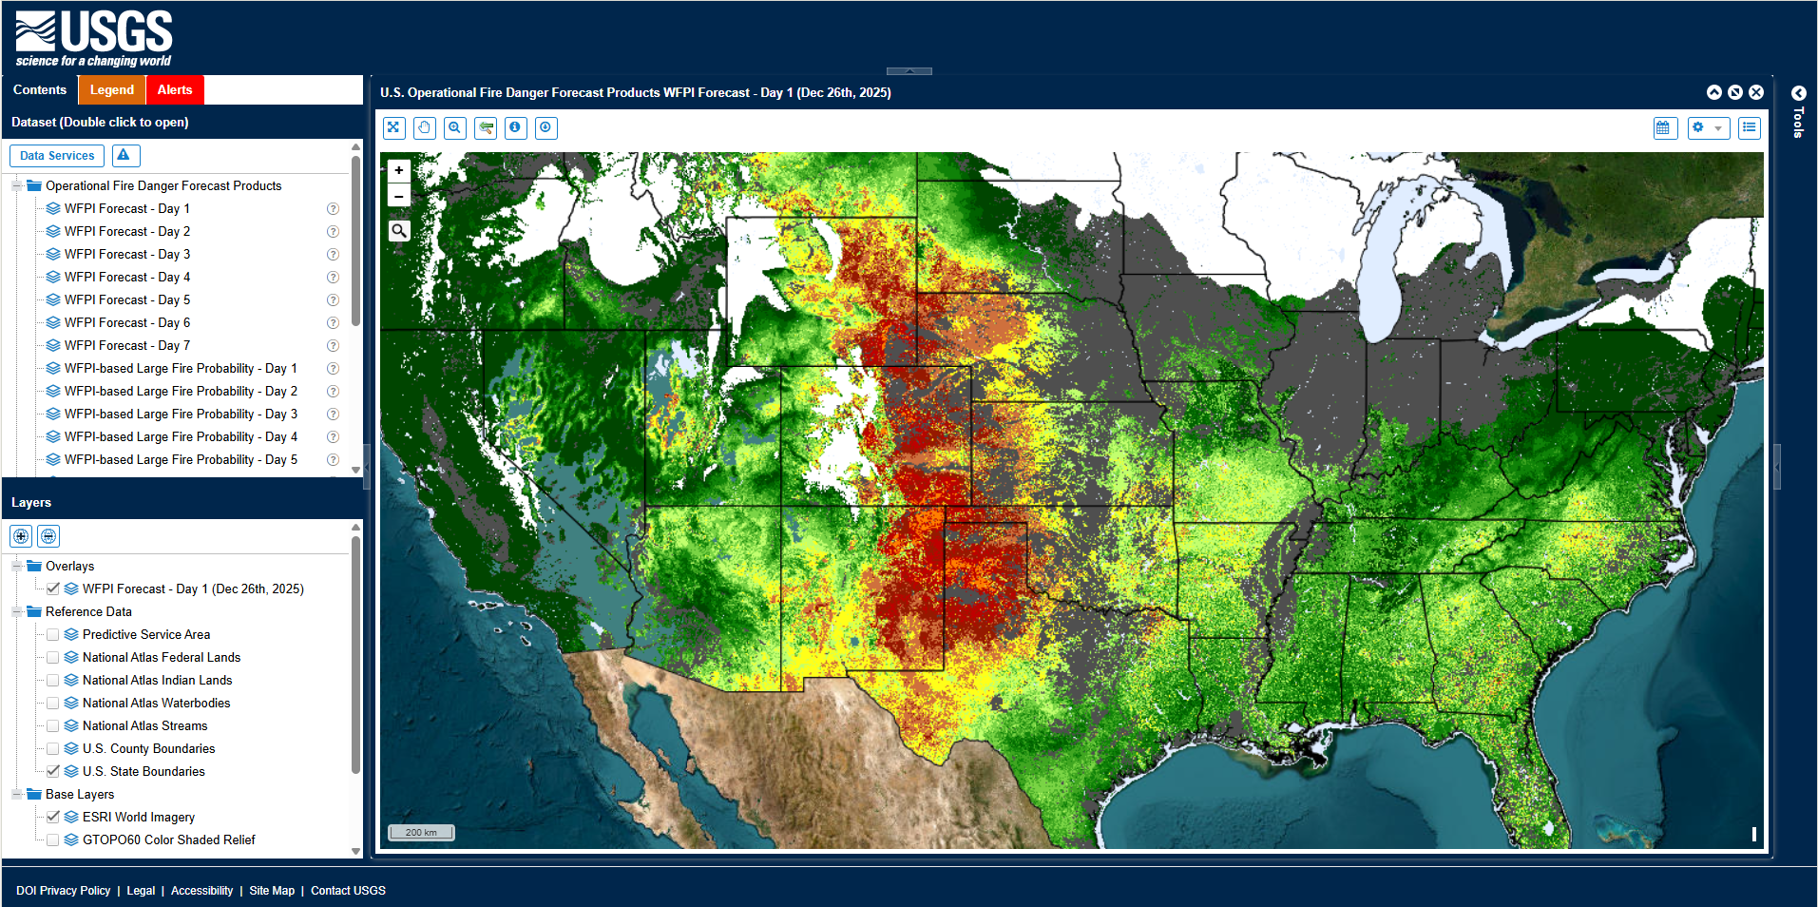
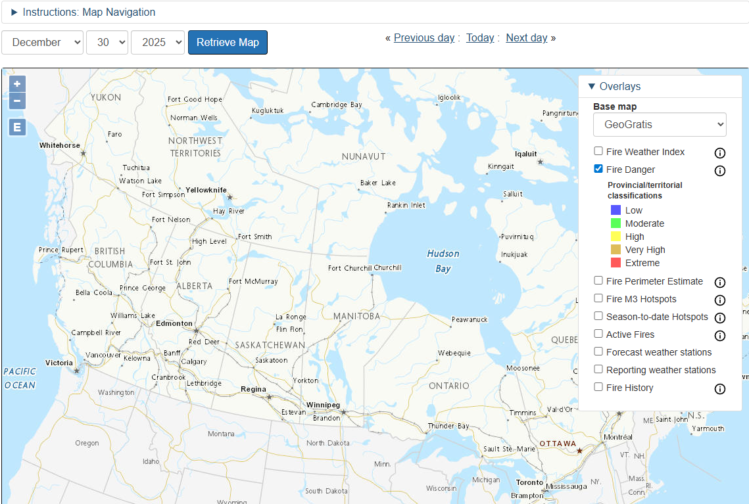
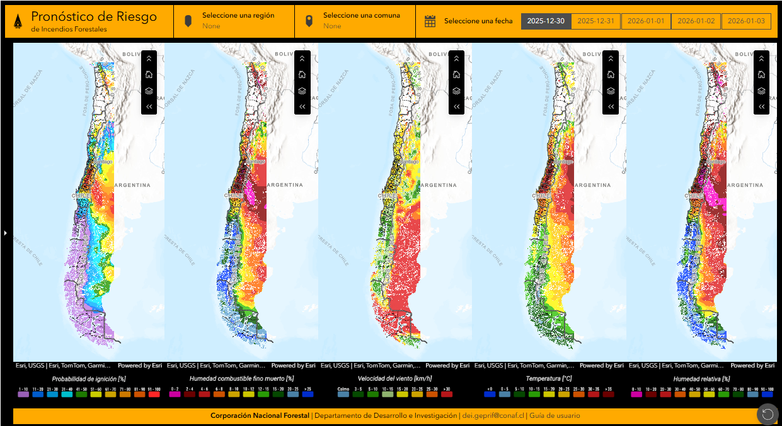
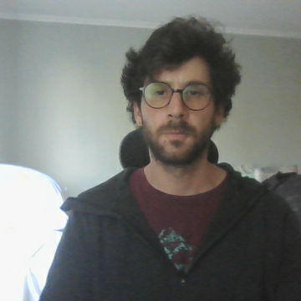
U.S. Operational Fire Danger Forecast
Canada’s Wildfire Information System
Chile’s Fire Risk Forecast
Notes:
To address this, I reviewed literature on fire-danger rating systems used globally— including the national fire risk systems of Canada, the U.S. and Chile,
Each country communicates this information in their own way.

Slide 4
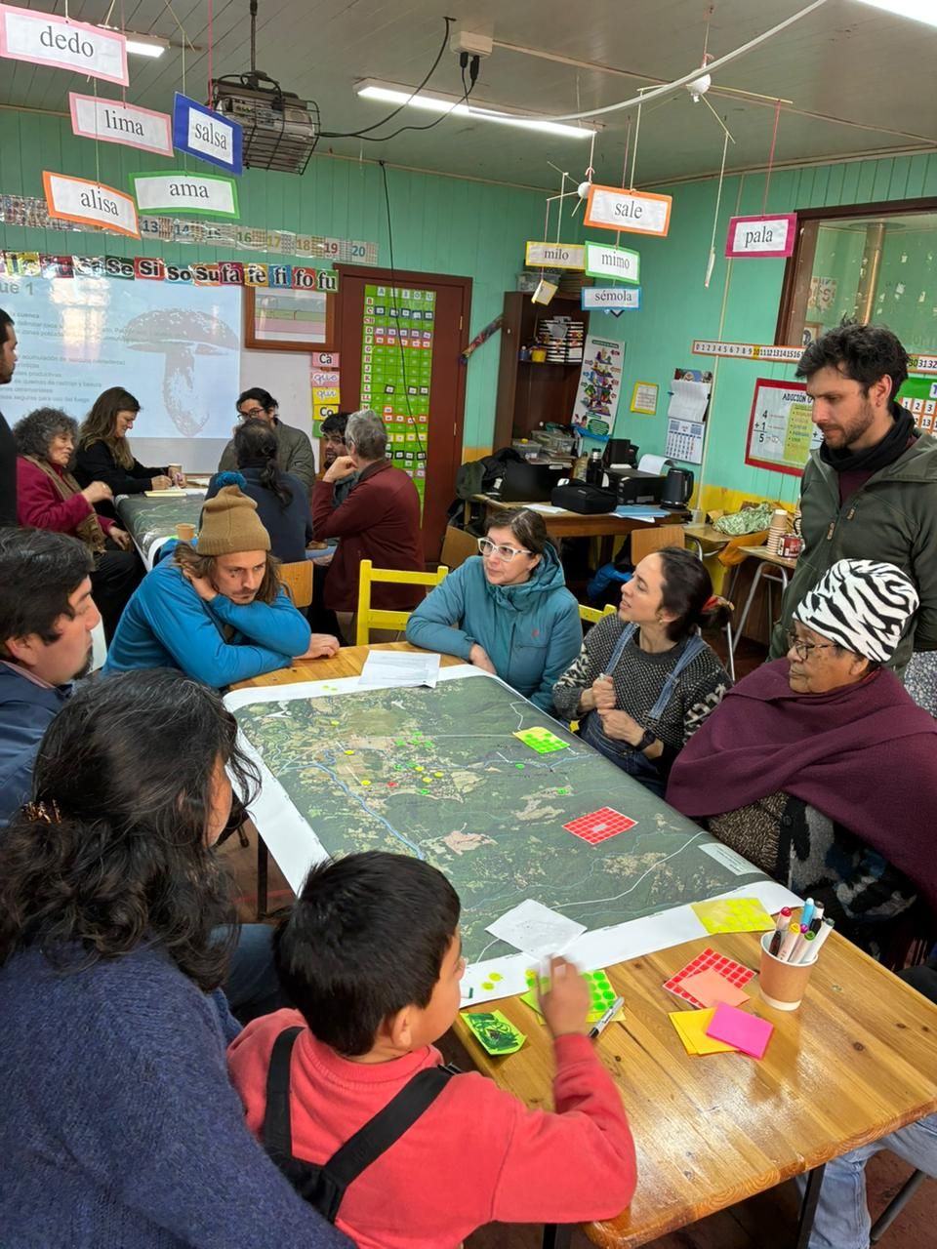

The main setback for all these examples are mainly 2:
They are mainly geared towards informing risk at a national scale, and
They are oriented towards highly educated audiences, requiring experience and knowledge in this type of dashboards to appropriately navigate.
The audience surrounding the area of Bosque Pehuén, called Palguín, is very different. They are mostly rural and indigenous communities with low educational level (mostly high school), with little if any experience on navigating this type of visualizations.
Because of this, my goal is to create an intuitive and accessible data visualization that can communicate current and forecast fire risk to local communities in the rural Andean Araucania region.
Wildfire prevention workshop, held at a local school in Palguín, Araucania Region, taken by Fundación Mar Adentro, 2025)
Notes:
In terms of visualization, all these examples have 2 main obstacles for the average audiences: 1) They are mainly geared towards informing risk at a national scale, which is mostly more information than the average user will need. And
2) They are not easy to use, requiring experience in this type of dashboards to appropriately navigate it.
The audience surrounding the area of Bosque Pehuén, the Palguín neigborhood, is very different. They are mostly rural and indigenous communities with low educational level (mostly high school), with little if any experience on navigating this type of visualizations.
So my goal is to create a dashboard tailored to this audience, so that I can enable all kinds of stakeholders in the area to make informed, timely decisions regarding fire prevention.

Slide 5


Risk Index Variables
Rodríguez-Moretti Index (IRM) (Dentoni & Muñoz, 2012)
Variable | Description | Index Value Score
Temperature (C°) | Higher temperatures increase flammability | 1 - 25
Relative Humidity (%) | Inverse relationship—dry air accelerates fire spread | 1 - 25
Wind Speed (km/h) | Critical variable for propagation and intensity | 1 - 15
Days Without Rain (N) | A drought indicator using a precipitation threshold of 2 millimeters | 1 - 35
Each variable receives a partial score from 0 to 100, in line with the IRM.
The dashboard computes risk scores for afternoon peak-fire hours—14:00 to 16:00 local time—when conditions are most critical.
Notes:
I used the Argentinian Rodriguez-Moretti system, using 4 relevant variables. These are Temperature, etc. etc.
Each variable receives a partial score from 0 to 100, and the added total score of the index indicates the level of risk of a wildfire occurring.
Now let me show you the actual dashboard

Slide 6
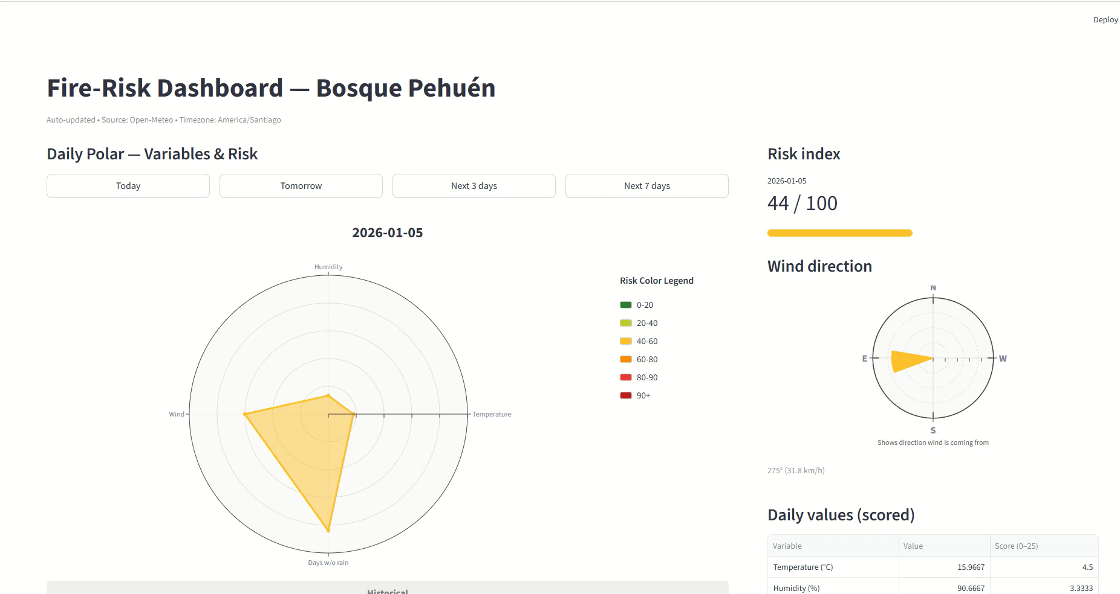
Notes:
Now, for the dashboard itself. What we can see is:
1. A polar coordinate plot that displays the 4 risk variables mentioned before as axes. Each variable is normalized to reflect its contribution to the fire risk score. The polygon's color reflects its total risk category as shown in the legend on the right. This view is meant to instantly communicates variable contributions and overall risk level, and on top it also has quick access buttons to check future dates
2. To the right you can see a polar compass that plots wind direction and speed using a wedge visualization. The wedge indicates the direction the wind is coming from and its length is scaled to wind speed. Color intensity reflects the associated risk level. This informs stakeholders on the probable fire spread direction and speed
3. Below this we have a tabular display that shows the real numerical values for each variable and its corresponding risk score. This might accommodate users who prefer precise numbers over visual representations.
4. I also included a 14-day bar chart that displays projected risk scores, color-coded by risk category. This can further be expanded to show the risk values for the next 2 weeks. This allows users to explore forecast patterns and high-risk windows. There is also a line chart below showing the actual values of each variable.
5. Finally, and as a work in progress, I added a map that shows that shows directional wind flow lines colored by intensity,—overlaying the region surrounding Bosque Pehuén (marked with a golden highlight). This visualization communicates regional wind patterns and how local conditions situate within the landscape.

Slide 7


Dashboard considerations:
Visualization is targeted towards the area of Palguin, in line with the target audience.
It has a simplified design and color scheme to efficiently communicate fire risks.
Quick view buttons at the top of the visualization allows for a rapid glance of future risks in the area.
A column chart shows the total risk score for the upcoming days to easily check future risk conditions
A map centered around Bosque Pehuén displays wind direction in the area to inform on possible fire spread if an outbreak occurs.
Key takeaways of the dashboard design:
Locally focussed
Accesible for a wider audience
Immediate risk communication (current and forecasted)
Reproducible
Notes:
Some of the key takeaways are that my visualization is very locally focussed for the target audience; its accesible for a wider audience than the Government’s fire risk platform; It immediately communicates fire risk; and its easily reproducible, since the data obtained can be found in any weather station.-
As my final words, I would like to once again thank Mr. Caban for the lectures and assignments given across these courses, and I hope that my p´resentations reflect all the insights that I gained during the program.
Thank you very much, goodbye

